Slide 1
Inventory Management System
Team Members:
Aman Mool(740303)
Jenish Prajapati(740317)
Manish Hyongoju()

Slide 2
Introduction
Inventory is stock of item held to meet future demand.
So, in other word it is collection of goods processed to form desired output to the organization.
system that helps people to control and keep track of the goods they buy, process, and sell.
helps companies identify which and how much stock to order at what time.
It tracks inventory from purchase to the sale of goods.
identifies and responds to trends to ensure there’s always enough stock to fulfill customer orders and proper warning of a shortage.

Slide 3
Objective
Easy Management of inventory
Handel details of sales, purchase, balance stock
Make Stock Manageable
Deals with day-to-day requirement of any production organization

Slide 4
Scope and Application
The main scope of this project is to tracks inventory from purchase to the sale of products in Departmental Store, Production organization, Medical Department etc.

Slide 5
Problem of Statement
Demand is frequently unpredictable in inventory systems, and lead times can often vary. Managers frequently keep a safety supply to minimize shortages. In such cases, it’s difficult to say what order amounts and reorder points will result in the lowest total inventory cost.

Slide 6
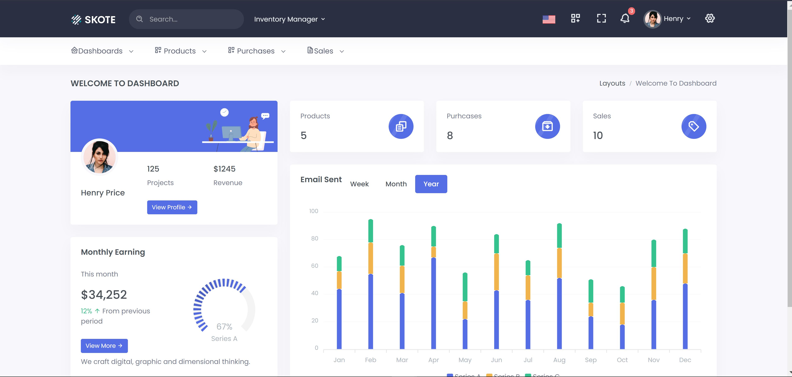
Output
Fig: Dashboard

Slide 7
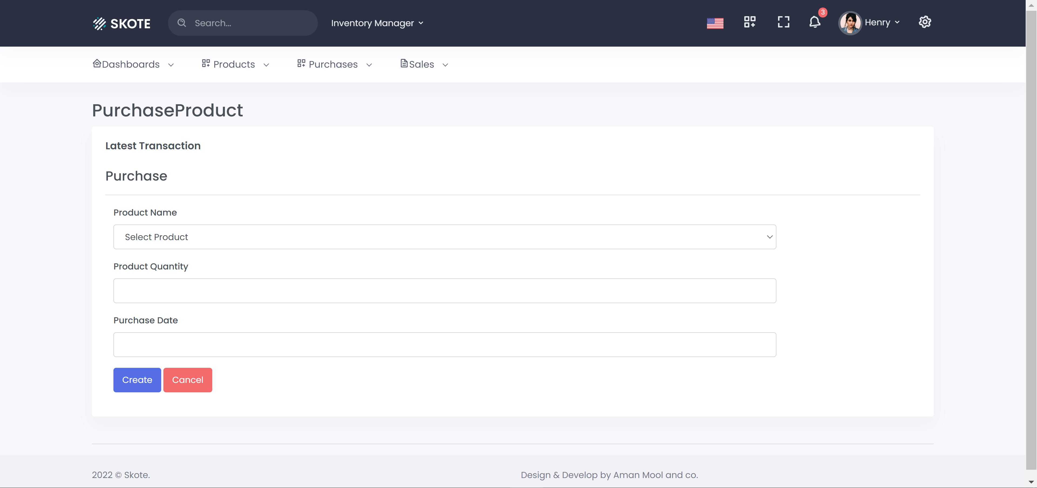
Fig 2: Product Purchase

Slide 8
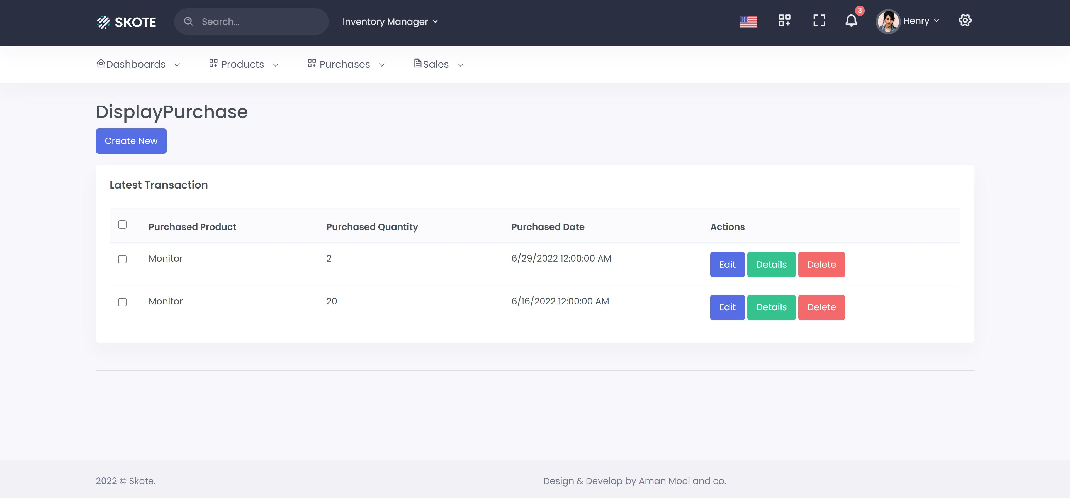
Fig 3:Display Purchase

Slide 9
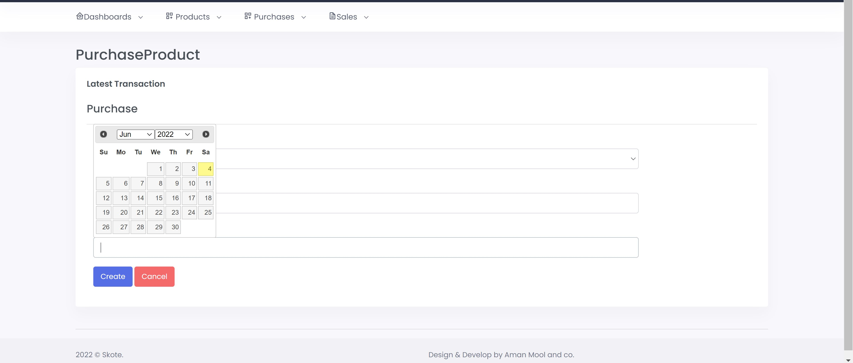
Fig 4:Purchase Product Date

Slide 10
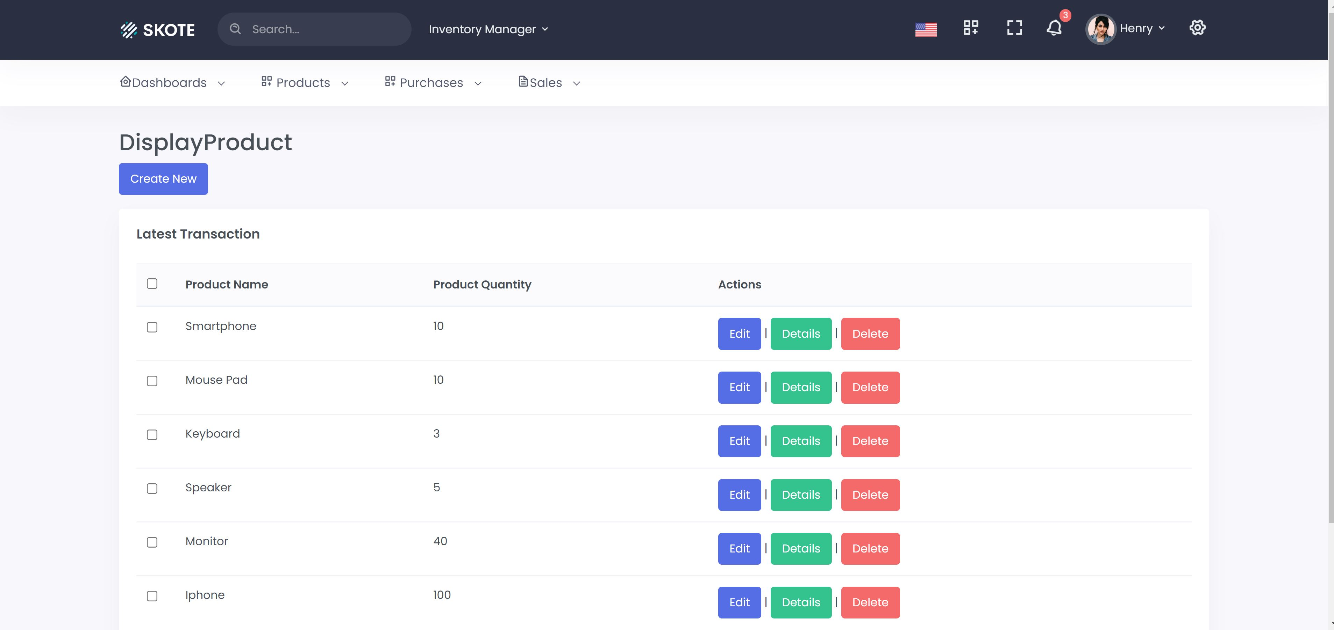
Fig 5:Display Product

Slide 11
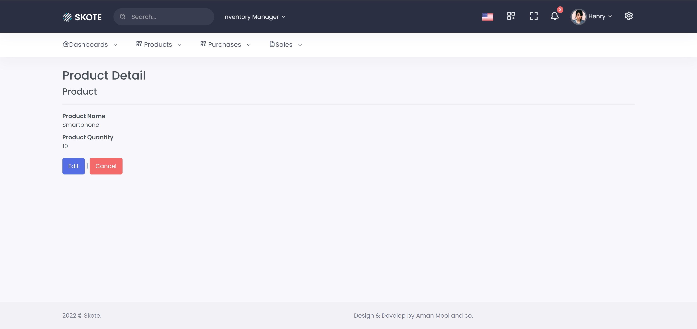
Fig 6: Product Details

Slide 12
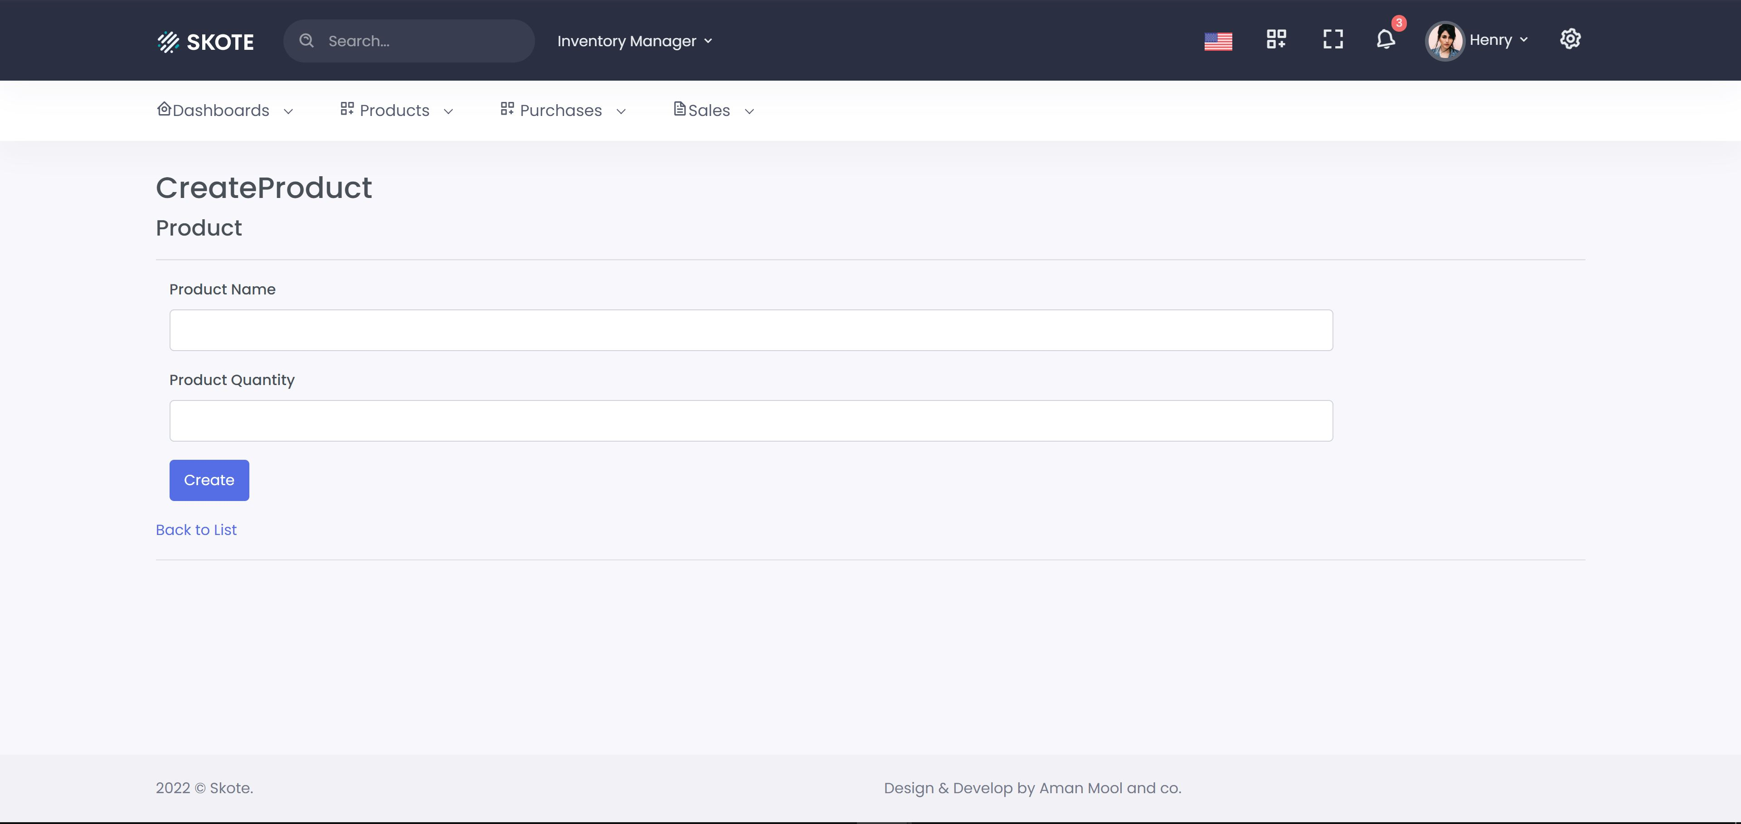
Fig 7:Create Product

Slide 13
Conclusion
Almost Accurate Output
Simple Desktop IMS application
Overall Productive Inventory Management

Slide 14
Limitations
Generate Simple Report
Small production Organization

Slide 15
Future Enhancement
Online payment System
System Flexible in any type
User authentication

Slide 16
Thanks!

